Slide 1
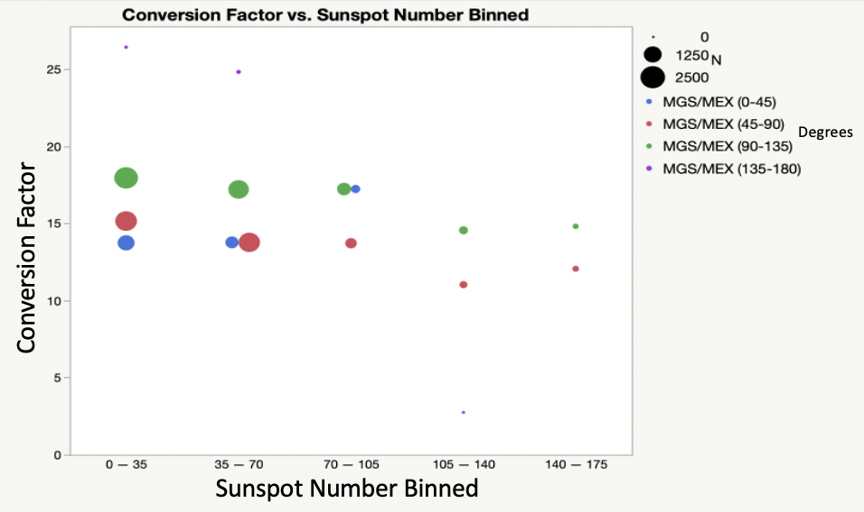
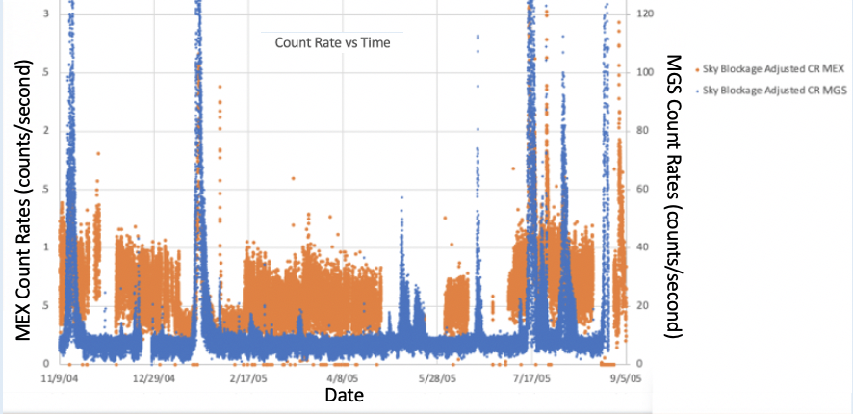
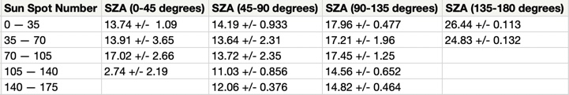
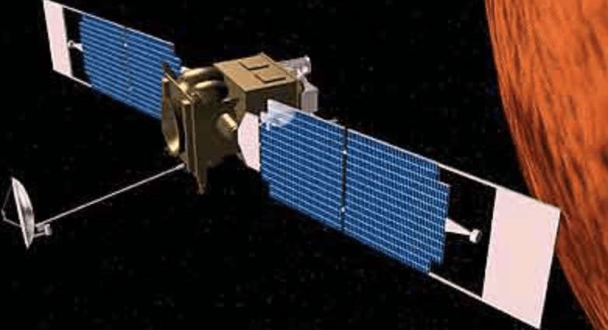
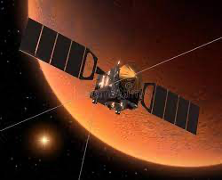
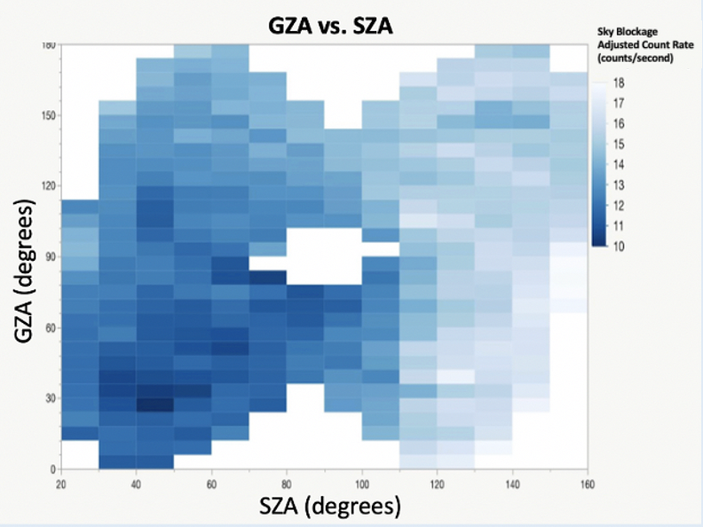
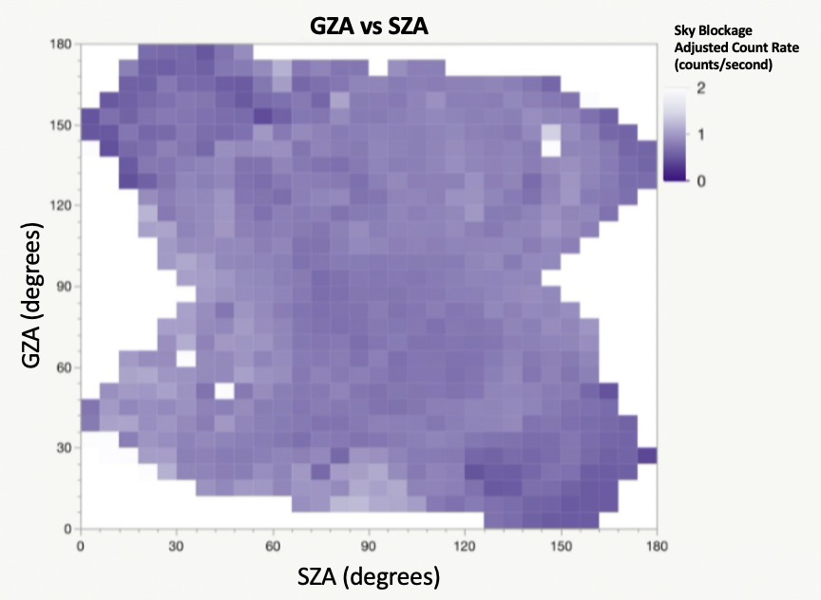
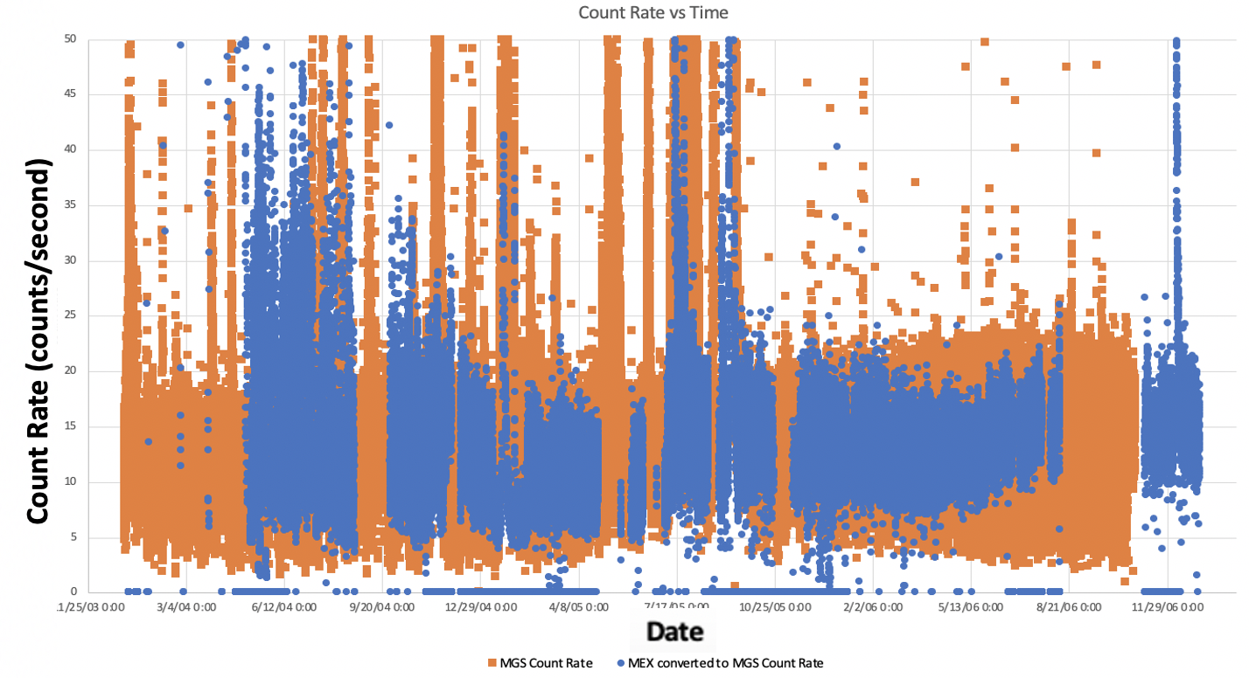
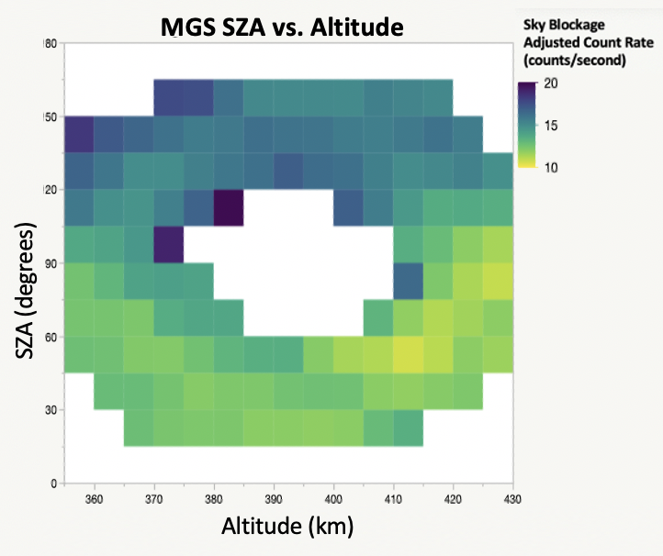
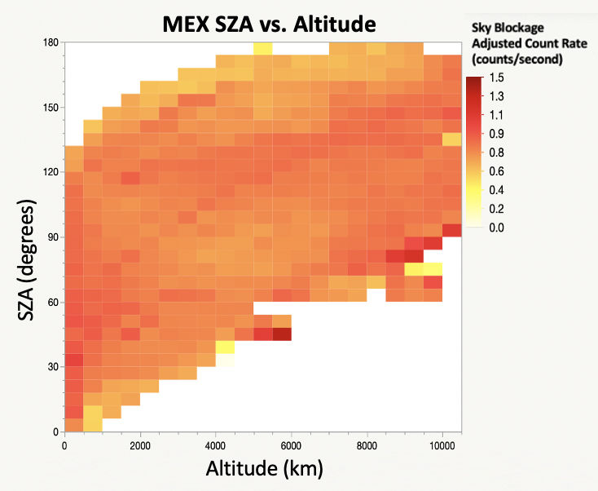
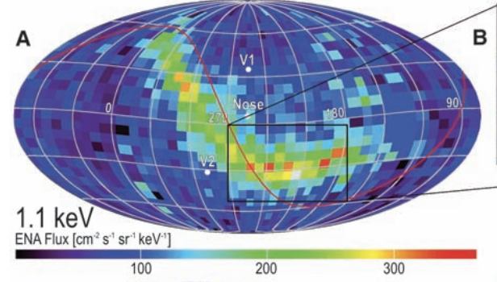

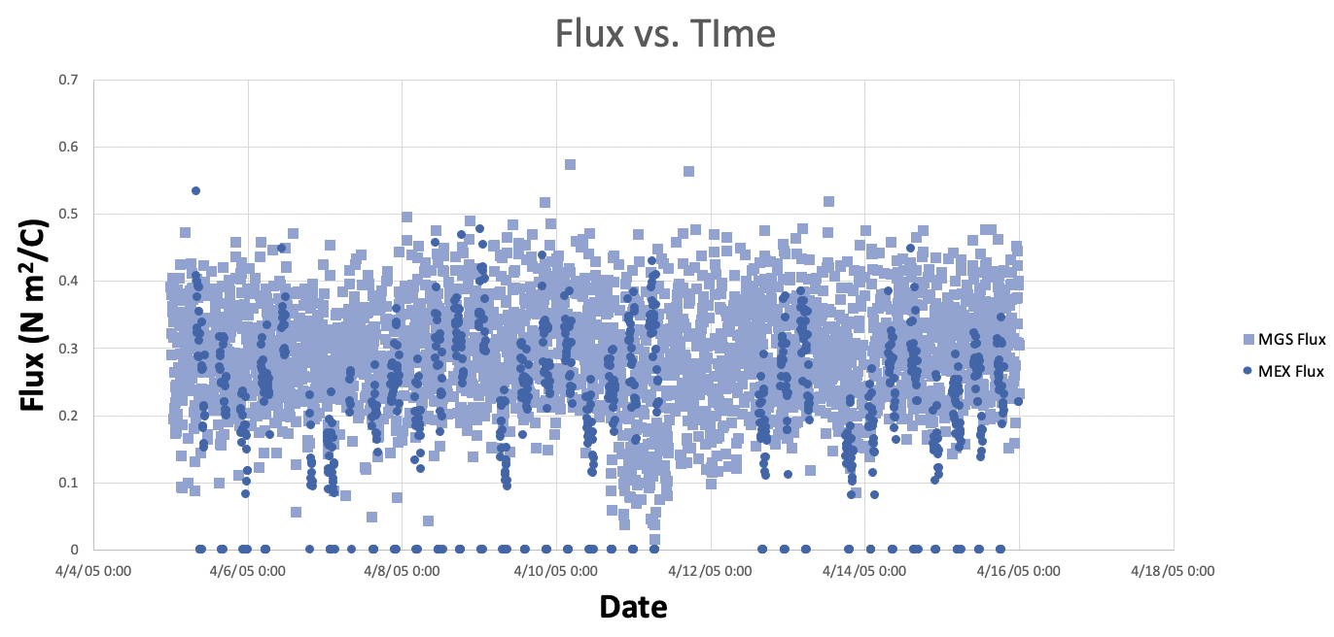

Understanding High-Energy Particle Radiation in Mars Orbit: Combining Data Sets from Mars Global Surveyor and Mars Express
Naomi Weiss^{1,2}, Robert Lillis², Christina Lee², Rudy Frahm³, David Mitchell²
¹Fremont High School, ²UC Berkeley Space Sciences Lab, ³Southwest Research Inst
Mars Background High Energy Flux Estimate
This plot illustrates conversion factor as a function of sunspot number where the color of a point corresponds to its SZA range. The conversion factor falls between 13 and 17 for most of the data. However, there are also seasonal effects, as Mars has a non-circular orbit around the Sun, which could lead to bias in the data and have not yet been accounted for.
Time Series of Overlaid Count Rates (Converted MEX and Original MGS)
Sample flux estimate plot created using the equation below [1] to translate MEX and MGS count rates of the highest energy channel, >30 MeV protons and ~2 MeV electrons, to particle flux.
Abstract and Background
The high energy charged particle environment (i.e. >30 MeV protons and ~2 MeV electrons) in Mars orbit is of interest both in terms of the science of the heliosphere and of the space radiation hazard to key orbital assets and astronaut health.
Examination of this radiation is made using data from the Mars Global Surveyor Electron Reflectometer (MGS-ER, 1997-2006) and the Mars Express Electron Spectrometer (MEX-ELS, 2004-present), which are both proxies for fluxes of these penetrating particles.
These particles have two primary sources: a) galactic cosmic rays which form a relatively steady background, varying by factors of 2 or 3, and b) solar energetic particles.
Here we have two primary goals. First, to understand the variability in these data sets, both temporal (during quiet times and SEP events) and with regards to factors such as altitude and the planetary zenith angles. Second, using these two data sets, we have constructed a consistent database of the penetrating particle radiation environment in Mars orbit from 1997 until the present.
General Trend
MEX and MGS count rate measurements for their overlapping times.
MEX to MGS Count Rate Conversion Factor
The table below depicts the different conversion factors from MEX to MGS count rates as a function of sunspot number, how active the Sun is at the time of measurement, and SZA.
Peaks are SEP events
Count Rate Dependency on Altitude, SZA, & GZA
SZA (Solar Zenith Angle): the angle formed between two lines connecting the spacecraft and Sun at Mars.
GZA (Galactic Zenith Angle): the angle between 2 lines, one connecting the nose of the heliosphere (pictured below) [2] with Mars and another between Mars and the spacecraft.
SZA and GZA:
MGS MEX
Altitude:
The MGS two-dimensional GZA vs SZA map shows that higher count rates occur on Mars solar and galactic nightside (from the tail of the heliosphere).
The SZA dependence means that high-energy particle flux generally comes more from the direction away from the Sun, while the GZA dependence indicates that the stronger magnetic field at the nose of the heliosphere deflects more particles, leading to higher fluxes from the tail.
The graphs on the right highlight the SZA dependence and show that there is no correlation between altitude and count rate once sky blockage has been accounted for.
Conclusion
The instruments on MEX and MGS that measure(d) highly energetic charged particles register the same events but have different sensitivities to them.
These count rates are dependent on SZA, GZA, and sunspot number, but not altitude once sky blockage has been accounted for. Using this, we can calculate conversion factors for translating between the two instruments.
By putting both datasets in terms of the MGS instrument, we may then use the equation delineated in the Delory paper [1] to convert from high energy count rates to flux, which yields a non-event time background of ~0.25 protons/cm²/s/sr.
Next Steps
Some next steps to be considered are the inclusion of seasonal effects in the sunspot data to eliminate any lurking variables. Additionally, comparing the converted MEX and original MGS count rates to each other through calculating their binned averages and standard deviations would allow us to see how well the datasets match each other, and if there are other variables that need to be considered.
References
[1] Delory, G. T., et al. (2012), Energetic particles detected by the electron reflectometer instrument on the mars global surveyor, 1999-2006, Space Weather, 10(6), doi:10.1029/2012sw000781
[2] McComas, D. J., et al. (2009), Global observations of the interstellar interaction from the Interstellar Boundary Explorer (IBEX), Science, 326(5955), 959–962, doi:10.1126/science.1180906
Flux (protons/cm²/s/sr)

